Slide 1

FINAL PROJECT PRESENTATION
Natural Language Processing Laboratory Final Review
Synthetic Slop Filter and Semantic Stylometric Engine
Project Title:
Project Domain:
Natural Language Processing and Machine Learning
Course:
Natural Language Processing Laboratory - ADA23DLU04
Presented by:
A Surya Kumar [E0324079] and J R Nikilesh Gajan [E0324098]
03-11-2026
1

Slide 2
Contents
Introduction
Problem statement
Literature survey
Objectives
Overall workflow
Truth methodology
Slop and style methodology
Tools and techniques
Implementation
Limitations and responsible use
Conclusion
Future scope and references
03-11-2026
2

Slide 3
Introduction
LLM responses can combine checkable facts with unsupported details and fluent filler.
Synthetic Slop Filter analyzes factual support and writing style as separate dimensions.
The app presents claim-level evidence, uncertainty labels, coverage, style components and highlighted text.
It is a local decision-support prototype: people still need to inspect the sources and use their judgment.
03-11-2026
3

Slide 4
Problem Statement
Main problem: generated text may sound confident even when some details are incorrect or unsupported.
A binary verdict hides the difference between evidence that supports a claim and evidence that is simply missing.
AI-writing detectors can make mistakes, so a single authorship label can be misleading.
Proposed approach: show claim evidence and unresolved cases, while keeping style indicators separate from factual checking.
03-11-2026
4

Slide 5
Objective
Main goal: build a local tool that helps users inspect factual support and style patterns in pasted text.
Claim analysis: extract check worthy claims and compare each with retrieved passages.
Transparent output: show supported, contradicted and unverifiable labels with evidence links.
Coverage awareness: report how many check worthy claims were resolved, separately from Truth %.
Style explanation: combine multiple writing signals and show components or highlights that a user can inspect.
Graceful operation: run locally on CPU and report warnings or fallbacks when optional models are unavailable.
03-11-2026
6

Slide 6
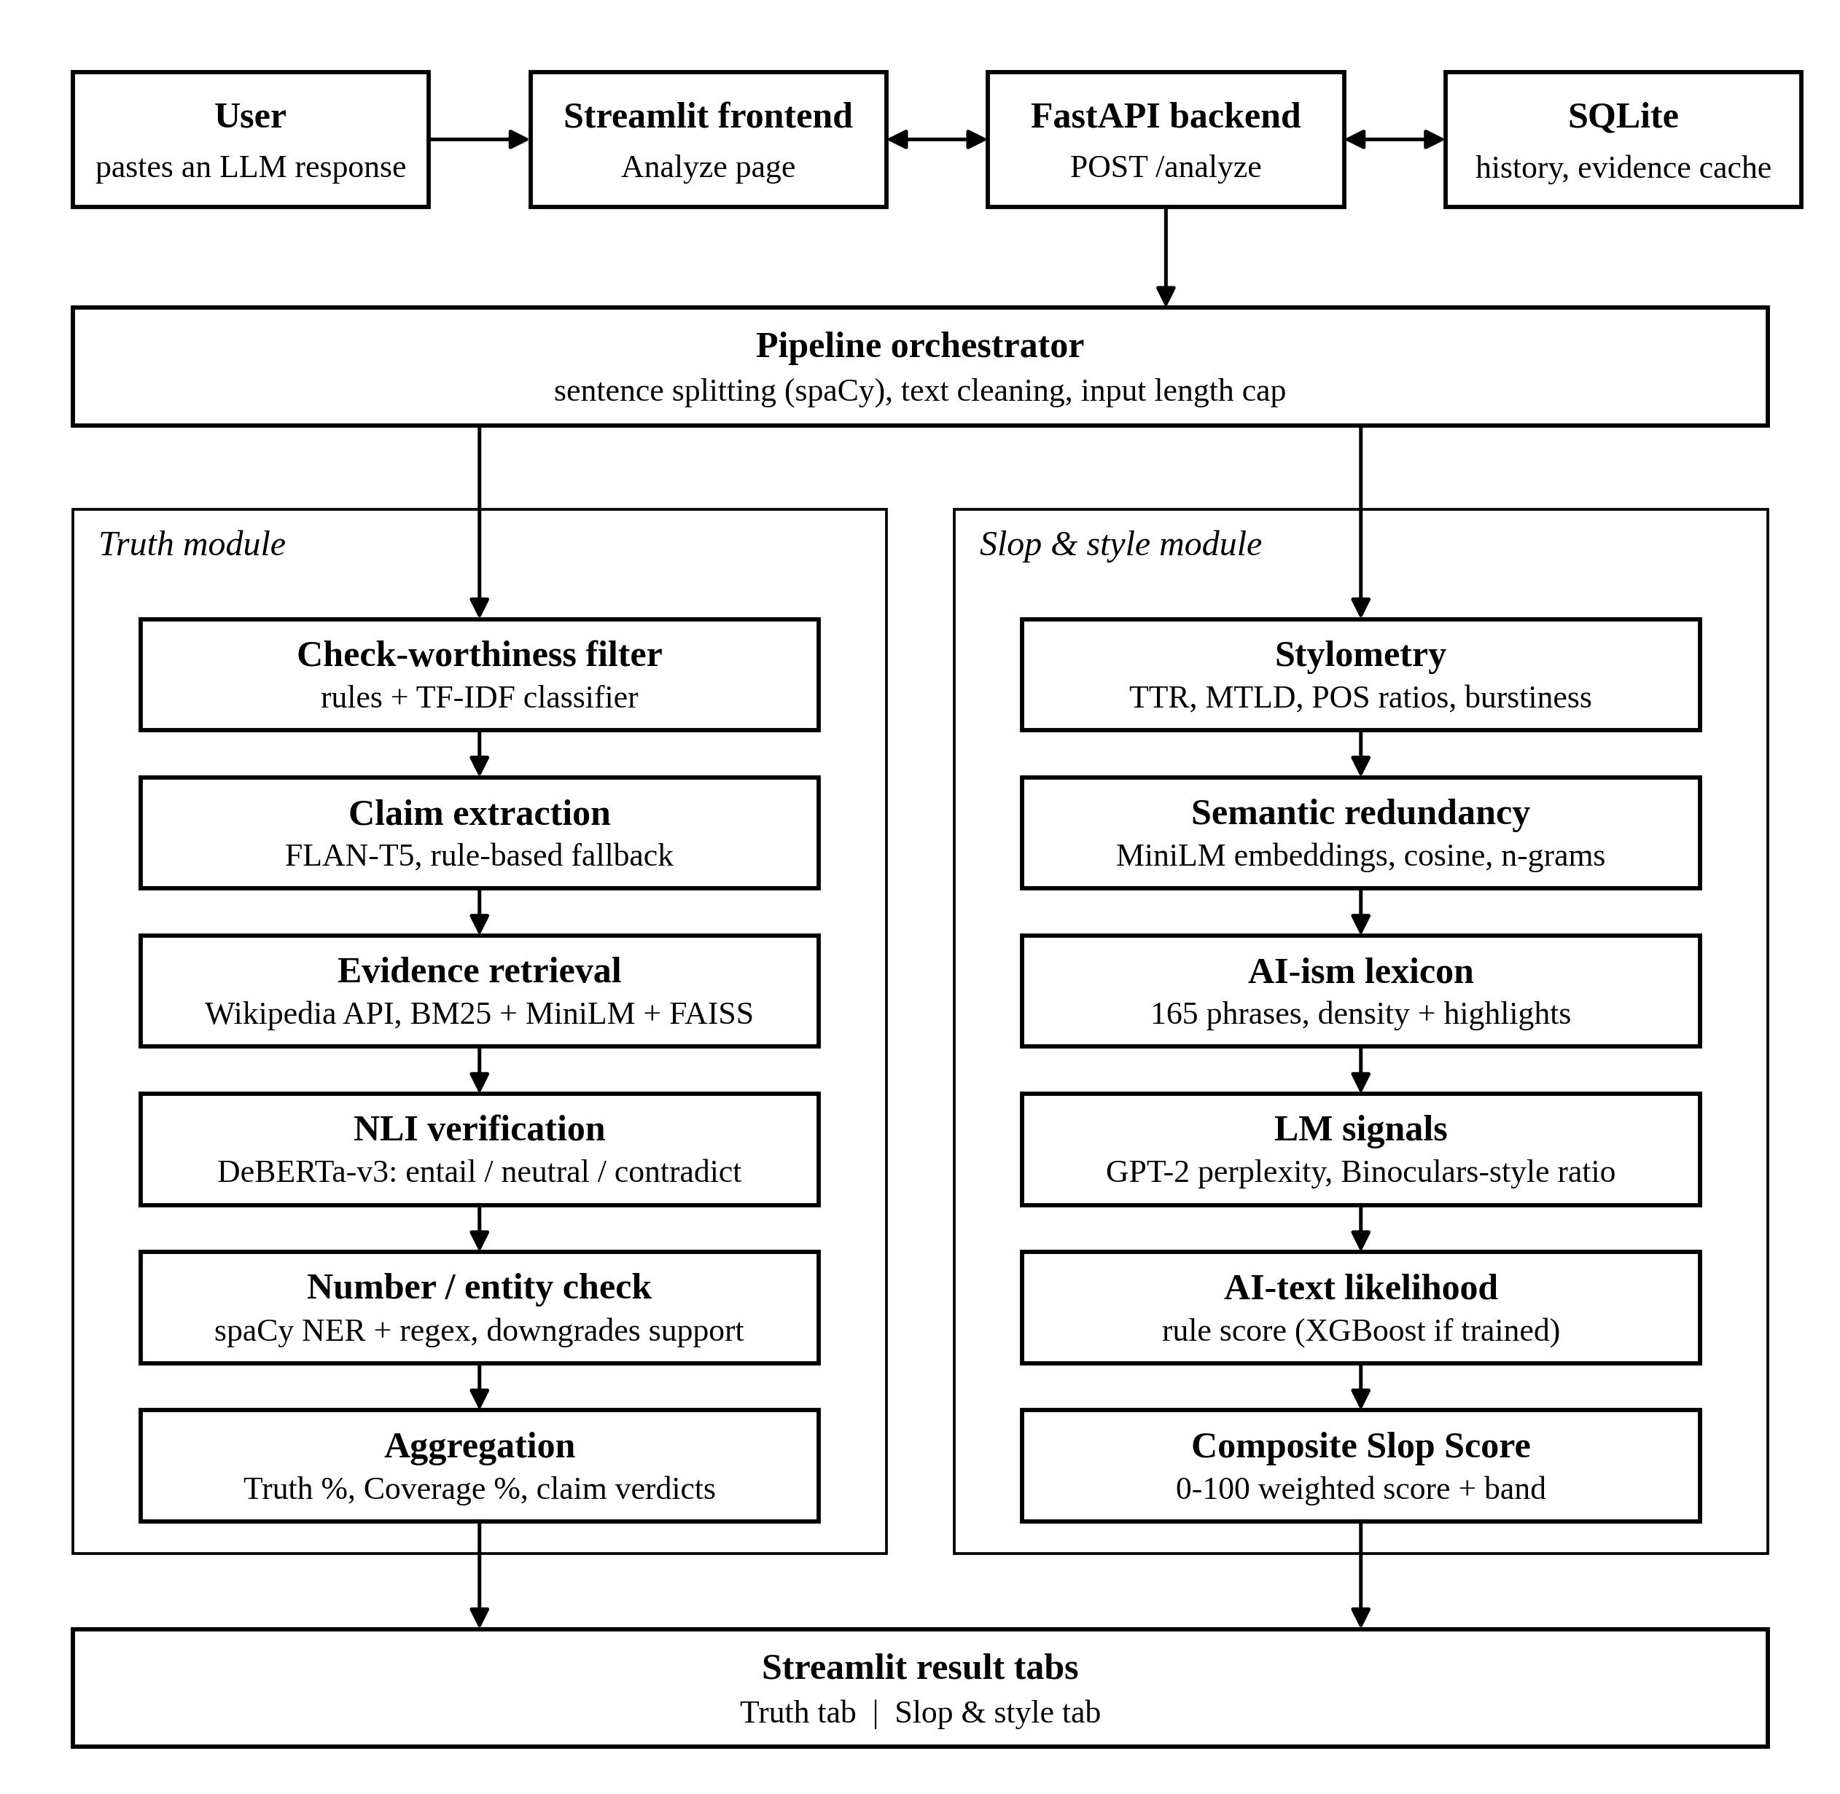
System Architecture

Slide 7
Methodology
Preprocess and split text; filter out opinions, questions and filler that are not checkworthy facts.
Extract factual claims with FLAN-T5 when available; use a rules-based fallback when needed.
Search English Wikipedia and rank passages using lexical BM25 and MiniLM embeddings with FAISS.
Compare claim and passage with DeBERTa natural-language inference; check numbers and named entities.
Assign supported, contradicted or unverifiable. “Unverifiable” means the available evidence did not resolve the claim.
Calculate Truth % over verifiable claims; show Coverage % as verifiable claims divided by checkworthy claims.
03-11-2026
8

Slide 8
Methodology
AI-likelihood signals — 0.40: approximate language-model signals; GPT-2 and DistilGPT-2 are small models.
Redundancy — 0.20: repeated wording and semantically similar sentences.
AI-ism phrase density — 0.25: phrase lexicon matching with highlighted spans.
Stylometry — 0.15: lexical, grammatical, sentence-length and readability patterns.
Available component weights are renormalized when a signal is missing; the output also shows the method and components.
The verified method was a rule fallback, not a trained XGBoost detector. Treat the score as a review signal, not proof of authorship.
03-11-2026
9

Slide 9
Tools and Techniques
Frontend: Streamlit single Analyze page with Truth and Slop & style tabs.
Backend: FastAPI; Pydantic schemas define the request and response.
Storage: SQLite through SQLAlchemy for analyses and a reusable evidence cache.
Text processing: spaCy sentence parsing and named-entity recognition.
Claim analysis: FLAN-T5 extraction, Wikipedia retrieval, BM25, MiniLM embeddings, FAISS and DeBERTa NLI.
Style analysis: Python feature extraction, an AI-ism lexicon, GPT-2 / DistilGPT-2 signals and a documented rule fallback.
03-11-2026
10

Slide 10
Literature Survey
Research work | Method / core idea | Connection to this project | Scope / limitation
FEVER (Thorne et al., 2018) | Claims are labeled SUPPORTS, REFUTES or NOT ENOUGH INFO. | Informs evidence-based claim labels and the need to retain unresolved cases. | Dataset task; it does not measure this application’s accuracy.
Sentence-BERT (Reimers & Gurevych, 2019) | Sentence embeddings can be compared with cosine similarity. | Related to semantic passage ranking and sentence redundancy signals. | Similarity helps find relevant text; it does not prove a claim.
DeBERTa (He et al., 2021) | Transformer with disentangled content and position attention. | The application uses a DeBERTa family model for entailment/contradiction scoring. | Model output depends on evidence and thresholds; it can still be wrong.
DetectGPT (Mitchell et al., 2023) | Studies probability-curvature signals for machine-generated text. | Provides related context for research on AI-text signals. | Not the detector used here; the verified Slop method was a rule fallback.
03-11-2026
5

Slide 11
Implementation
User interface: frontend/app.py accepts pasted text and sends module settings to the API.
API: POST /analyze validates the input and returns claims, evidence, metrics, warnings and timings.
Orchestration: backend/app/services/pipeline.py coordinates preprocessing, retrieval, verification and style analysis.
NLP modules: backend/app/nlp/ contains claim, retrieval, verification, stylometry and scoring components.
Data path: user-supplied text is analyzed; English Wikipedia provides retrieved evidence; SQLite caches analysis data.
Fallback design: model-dependent steps load lazily and can return warnings with rule-based alternatives.
Run locally with the supplied PowerShell scripts: backend at port 8000 and Streamlit at port 8501.
03-11-2026
11

Slide 12
Limitations
Evidence retrieval currently uses English Wikipedia; relevant, recent or niche sources may be missing.
NLI can misread negation, numbers, aliases, context and facts that require multiple reasoning steps.
Unverifiable is not false; always read claim rows, evidence and Coverage % together with Truth %.
Style indicators can produce false positives and false negatives; they do not establish who authored a text.
The verified Slop method used a rule fallback. No benchmark accuracy, calibration result or cross-generator evaluation is available.
Use the app to guide inspection, not to make high-stakes or disciplinary decisions.
03-11-2026
12

Slide 13
Conclusion
Synthetic Slop Filter combines evidence-based claim review with a separate analysis of writing-style signals.
Claim verdicts and retrieved passages make the factual analysis inspectable; coverage communicates unresolved claims.
The style score exposes component signals and highlights, but remains a heuristic indicator in the verified setup.
The application is a working local prototype for human review, with source-backed evidence and visible uncertainty.
03-11-2026
13

Slide 14
Future Scope
Build a carefully labeled claim-and-evidence dataset for evaluation.
Measure claim-level precision, recall, F1 and retrieval coverage on held-out examples.
Calibrate confidence scores and test across topics, writing styles and generators.
Expand retrieval beyond English Wikipedia and make source dates and provenance clearer.
Train and evaluate the slop classifier only after collecting suitable human and generated text.
Study false positives and add clear uncertainty guidance for all users.
03-11-2026
14

Slide 15
References
[1] Thorne, J., et al. “FEVER: a large-scale dataset for Fact Extraction and VERification.” NAACL-HLT, 2018.
[2] Reimers, N. & Gurevych, I. “Sentence-BERT: Sentence Embeddings using Siamese BERT-Networks.” EMNLP-IJCNLP, 2019.
[3] He, P., Liu, X., Gao, J. & Chen, W. “DeBERTa: Decoding-enhanced BERT with Disentangled Attention.” ICLR, 2021.
[4] Robertson, S. & Walker, S. “Some Simple Effective Approximations to the 2-Poisson Model for Probabilistic Weighted Retrieval.” SIGIR, 1994.
[5] Douze, M., et al. “The Faiss library.” arXiv:2401.08281, 2024.
[6] Guo, B., et al. “How Close is ChatGPT to Human Experts? Comparison Corpus, Evaluation, and Detection.” EACL Findings, 2023.
03-11-2026
15

Slide 16
Thank you
03-11-2026
17

